Slide 1
ContrastScore
Smarter, Fairer, Faster Text Evaluation
A Contrastive Preference Learning Approach for Automatic Metric Learning
Presented by:
Hammad Anjum 21L-6271
Hammad Ashraf 21L-6275
Nareen Waseem 21L-6270
Fiza Shehzad 21L-7693

Slide 2
Meet the Authors
Name | Affiliation
Xiao Wang | University of Manchester
Daniil Larionov | University of Mannheim
Siwei Wu | University of Manchester
Yiqi Liu | University of Manchester
Steffen Eger | University of Technology Nuremberg
Nafise Sadat Moosavi | University of Sheffield
Chenghua Lin | University of Manchester

Slide 3
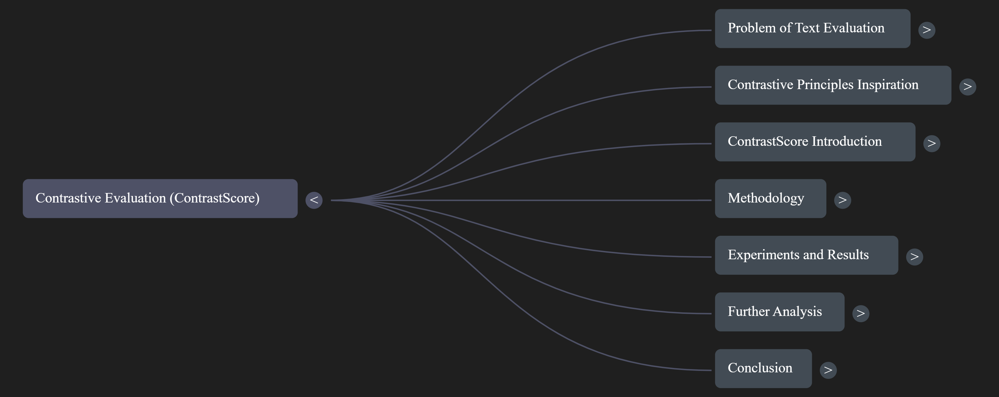
Road Map

Slide 4

Introduction
Text evaluation: as hard as text generation
Existing metrics show weak alignment with human judgment
New solution: ContrastScore leverages expert-amateur model contrast

Slide 5

1. Problem of Text Evaluation
Fundamental NLP challenge
Hard to capture semantic quality
Traditional metrics struggle with variability and nuance

Slide 6

1.1 Challenges in Automatic Evaluation
BLEU, ROUGE focus on n-gram overlap
Fail to capture meaning or paraphrases
Dependence on high-quality references
BERTScore better semantically, but still limited

Slide 7

1.2 Weak Correlation with Human Judgments
Metrics often rate semantically strong outputs poorly
Summarization tasks suffer from reference variability
BERTScore shows only moderate human agreement

Slide 8
Large models perform better, but are costly
Biases: likelihood bias, length bias, social bias
Prompt sensitivity is a serious limitation
1.3 Limitations of LLM-Based Metrics

Slide 9
2. Contrastive Principle: Inspiration
Inspired by contrastive decoding and SCMoE
Models of different capacities compared
Goal: better calibration, less bias

Slide 10

2.1 Contrastive Decoding
Uses log-probability difference for better text generation
Avoids repetition and incoherence
Ratio-based scoring unsuitable for evaluation

Slide 11

2.2 ContrastScore’s Evaluation Formula
Subtraction-based formula for stability
Score = ∑ log(|P_EXP - γ × P_AMA|)
Handles low-probability tokens
Better aligned with human judgment

Slide 12
2.3 Contrastive Model Architecture (SCMoE)
SCMoE uses internal contrast in one model
No need for external weak model
ContrastScore uses external weak model for scoring
Inspired by structured model disagreement

Slide 13
Methodology
Current issue: Single-model evaluation metrics lead to bias and instability.
Solution: ContrastScore uses two models: an expert model and an amateur model.
Key Formula:
Benefit: Evaluates based on disagreement between expert and amateur, addressing bias in current models.
Outcome: Aligns better with human judgments, produces more stable and fair evaluations.

Slide 14

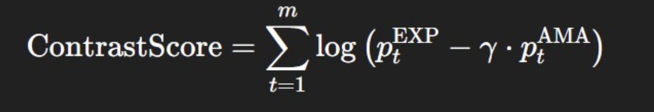
Methodology
Evaluation framework: Extends probabilistic text evaluation methods (e.g., BARTScore).
Old approach: Contrastive Decoding assigns −∞ to tokens outside top choices, rejecting valid sequences.
Key Formula (from Contrastive Decoding):
(Used for next-token prediction but unsuitable for full evaluation.)
ContrastScore formula: Uses a subtraction-based contrastive approach with scaling factor γ.
Advantage: Retains all tokens, adjusts based on model disagreement, leading to stable evaluation.

Slide 15
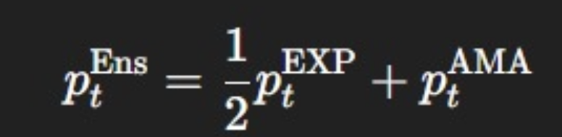
Experimental Setup for ContrastScore Evaluation
• Tasks Evaluated:
Machine Translation: WMT23 dataset (EN-DE, ZH-EN, HE-EN)
Summarization: SummEval dataset (CNN/DailyMail articles)
•Models Used:
Llama and Qwen families (0.5B, 1B, 3B, 7B, 8B) for generalizability
•Comparison:
Single-model evaluation
Ensemble evaluation: Averaged probabilities for expert and amateur models
Ensemble Probability Formula:

Slide 16
Evaluation Metrics & Hyperparameters
Evaluation Dimensions:
Correlation with Human Scores: Pearson correlation to assess alignment with human judgments.
Bias Evaluation:
Likelihood Bias: Quantified using BiasScore:
BiasScore=ρ(LS,US)
Length Bias: Evaluates bias towards longer texts.
Efficiency: Number of samples processed per second.
Hyperparameters:
Scaling factor γ for amateur model set to 0.1.
Decoding Temperatures: τ₁ = 1.5, τ₂ = 0.5.
Environment: Experiments run on GPU clusters (4× H100 GPUs).

Slide 17
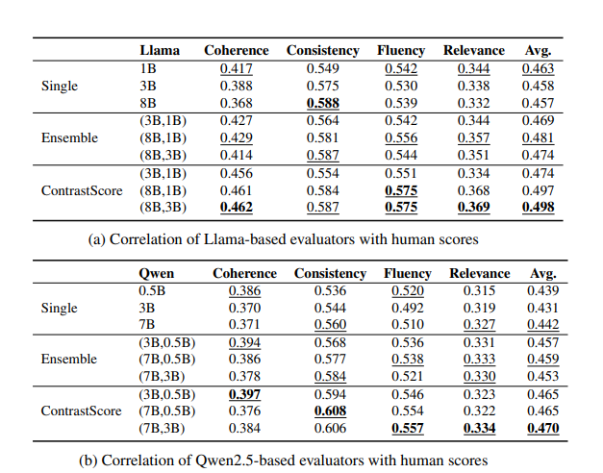
Results
ContrastScore can achieve correlation scores better than those of the largest model—using only two smaller models.
Ensemble in Llama methods produce less accurate results than the single models
ContrastScore using
(expert, amateur)=Qwen(7B, 0.5B) improves correlation over
single 7B by 5.8% and
ensemble of Qwen(7B, 0.5B) by 5.8%.

Slide 18
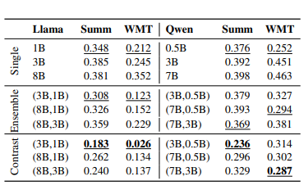
Results
ContrastScore with Llama(8B, 3B) improves correlation by 9.0% over the single Llama 8B.
ContrastScore with Llama(3B, 1B) exceeds the single Llama 8B by 3.7%.
ContrastScore with Qwen(3B, 0.5B) outperforms the single Qwen 7B by 5.2%.

Slide 19
Bottomline
ContrastScore consistently outperforms both single-model and ensemble approaches across diverse settings.
Accuracy ↑ Bias ↓ Speed ↑

Slide 20
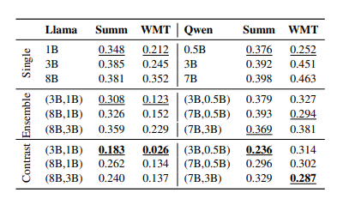
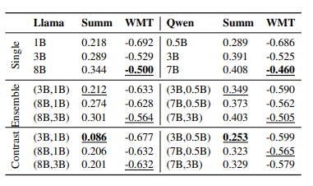
Bias Analysis
Likelihood Bias
Length Bias
ContrastScore with Llama (8B, 3B) reduces the likelihood bias by 37.0% and 61.1% compared to single Llama 8B in summarization and machine translation task
ContrastScore with Qwen (7B, 0.5B) results in a reduction of 25.6% and 34.8% compared to single Qwen 7B model for the same tasks.
Notably, ContrastScore with Llama (3B,1B) lowers the bias score from 0.289 to 0.086.
Qwen (3B,0.5B), ContrastScore reduces the bias score from 0.349 to 0.253.

Slide 21
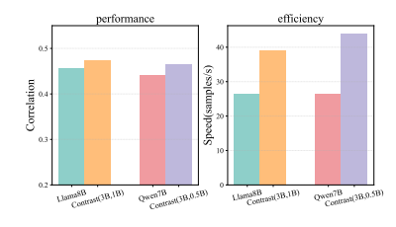
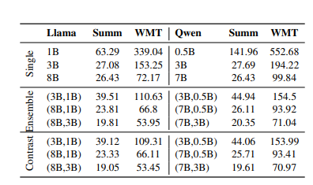
Other Metrics

Slide 22

Weighted Ensemble
Refers to averaging the probabilities of next token that is predicted by both the expert and amateur model.
Conduct a parameter sweep on the summarization task using Llama3.2 (3B, 1B), varying γ from 0 to 1 with a step size of 0.05.
Achieves its highest performance at γ = 0.55, with an average correlation of 0.4694.
More importantly, ContrastScore (0.474) outperforms the optimal setting of weighted ensembling (0.469) in correlation.

Slide 23
Qualitative Analysis
case study (Machine Translation)
Sentence: “产品防伪标识在哪里”
“Where is the product anti-counterfeit label?”
Results:
expert model mis-ranked Hypothesis 1 as the “second-best translation” ,
whereas human evaluators rank it 1
expert model assigning a very low probability (0.000457) to “logo”
In Contrast:
The Amateur model assigned a significantly higher probability (0.06592) to “logo”
ContrastScore leveraged this probability discrepancy to adjust the probability of “logo”, increasing the overall score of Hypothesis 1.

Slide 24
RECAP & Conclusion…

Slide 25
GOAL?
We want Ai models that generate higher quality answers.
PROBLEM?
while training, we need METRICS to automatically VALIDATE if the generated text is HIGH QUALITY!
WHAT NOT WORKS?
Why?
comparing RESPONSES with Human generated reference text
No single true right response
use Big LLM’s (ChatGPT, DeepSeek) for Quality Validation
Big LLM’s are Biased and VERY expensive
Means they favor longer responses, hallucinate, misunderstand context
Then what else can we do?

Slide 26
Then what else can we do?
How can we overcome biasness?
Use ensembles (combine outputs from multiple models).
What can we call this approach?
But what about expense?
This is the essence of ContrastScore.
It reduces expenses, while resulting in responses closer to human judgment
“It evaluates based on disagreement between expert and amateur, addressing bias in current models.”
We reduce it drastically by comparing the results of a strong model (expert) and a weaker model (amateur), using their disagreement to score text.

Slide 27
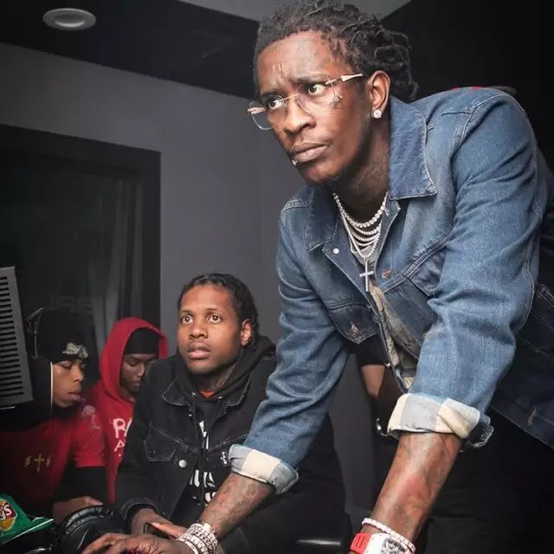
We reduce it drastically by comparing the results of a strong model (expert) and a weaker model (amateur), using their disagreement to score text.
Kinda like in this meme
*expert*
*you guys*
*amateur*
Now let’s look at some results of this amazing technique…

Slide 28
Summary of Findings
ContrastScore offers higher accuracy by aligning better with human judgment.
It reduces bias (length, likelihood) significantly.
It’s faster and cheaper than large single-model evaluations.
It works consistently across tasks like translation and summarization. (As we have seen in results)

Slide 29
THANK YOU FOR LISTENING!
Feel free to ask questions…

